Slide 1
Declarative Programming

Slide 2
Stateful vs Stateless
class Math
{
public int Add(int x,int y)
{
return x+ y;
}
public int Sub(int x,int y)
{
return x- y;
}
}
class Account
{
double balance;
public void withdraw(double amt)
{
balance -= amt;;
}
public void deposit(int amt)
{
balance += amt;
}
}

Slide 3
Procedure
var value = 0
func increment() -> Int {
value += 1
return value
}
Function
func increment(value: Int) -> Int {
return value + 1
}

Slide 4
Stateful(mutable)
var value = 0
func increment() -> Int {
value += 1
return value
}
Stateless(immutability)
func increment(value: Int) -> Int {
return value + 1
}

Slide 5
Referential Transparency
Means that an expression always evaluates to the same result in any context.

Slide 6
def sum(upTo):
sum = 0
for i in range(0,upTo):
sum += i
return sum;
res = sum(10)
print(res)
Notes:
Tail Recursion

Slide 7
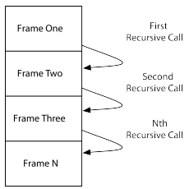
def sum(upTo):
if (upTo == 0):
return 0
else:
return upTo + sum(upTo - 1)
res = sum(10)
print(res)
Notes:
Recursion
has its own problems, though; in particular, each recursive call will lead to
another frame on the program’s call stack.

Slide 8

Notes:
Trampoline
there is a technique to work around the lack of tail recursion, called "trampolined style". It allows us to write recursive programs that avoids growing the call stack, even in languages that don't natively support tail call elimination. That is, each recursive call is returned to tramp and is bounced off of it.
What are the takeaways?
This technique only works for tail-recursive functions. The recursive call must be the last thing the function does.
The translation to a trampolined generator is easy! Just turn the return statements into yield expression.
Although this will protect your stack, creating a generator for each call is probably slow.
Instead of making
mutually recursive calls directly, we return a function that would make the
desired call, and we let the compiler or runtime take care of the rest.

Slide 9

Side Effects
A necessary evil: they can surprise us
and break the Least Astonishment Principle
Notes:
The principle of least astonishment (POLA), sometimes also referred to as Principle of Least Surprise, applies to user interface and software design, from the ergonomics standpoint. In general engineering design contexts, the principle may be taken to mean that a component of a system should behave in a manner consistent with how users of that component are likely to expect it to behave, i.e., users should not be astonished at the way it behaves.
A website may declare an input that should autofocus when the page is loaded,[8] such as a search field (e.g. Google.com), or the username field of a login form. Sites offering keyboard shortcuts often allow pressing ? to see the available shortcuts. Examples include Gmail[9] and JIRA.[10]
The F1 Function key in Windows operating systems is almost always for opening a help program associated with an application, and similarly for some of the Linux desktop environments. The corresponding key combination in Mac OS X is ⌘ Command+⇧ Shift+?. Users expect a help screen or similar help services popup when they press this key. Software binding this key to some other feature is likely to cause astonishment if no help appears. Malicious programs are known to exploit users' familiarity with regular shortcut keys.[11]
In programming, a good example of this principle is the common ParseInteger(string, radix) function which exists in most languages and is used to convert a string to an integer value. The radix is usually an optional argument and assumed to be 10 (representing base 10). Other bases are usually supported (like binary or octal) but only when specified explicitly; when the radix argument is not specified, base 10 is assumed. Notably Javascript did not originally adopt this behaviour, which resulted in developer confusion and software bugs.[12]

Slide 10

principle of least astonishment
the name of a function should reflect what it does

Slide 11
• modifying a global variable or static variable
• modifying one of the functions arguments
• raising an exception
• writing data to a display or file
• reading data from a file or database
• calling other side-effecting functions

Slide 13

Temporal Coupling
A consequence of side effects
the caller of GetDataReader must always remember to call close when they are finished to close the DB connection.
Leads to mysterious code
“Hack!! No one told me that I should have called .initialize() first !!"
Notes:
Can be partially avoided by passing a block
Execute on connection ( set_of_instructions )
Spring’s JdbcTemplate, RestTemplate, …
Java8 lambdas make it a lot easier ()->{stuff;}

Slide 14
let array = [0, 1, 2, 3, 4, 5]
var evenNumbers = [Int]()
for element in array {
if element % 2 == 0 {
evenNumbers.append(element)
}
}
Imperative
Declarative
let array = [0, 1, 2, 3, 4, 5]
let evenNumbers = array.filter { $0 % 2 == 0 }

Slide 15
var data = [1, 2, 3, 4, 5];
var numbers = data.map(function (nr) { return nr + 1; });
// numbers = [2, 3, 4, 5, 6]
Notes:
----- Meeting Notes (27/11/14 18:27) -----
Transformieren

Slide 16
var data = [1, 2, 3, 4, 5, 6, 7]; var numbers = data.filter(function (nr) { return nr % 2 === 0; });
// numbers = [2, 4, 6]

Slide 17
var data = [1, 2, 3, 4, 5, 6, 7]; var numbers = data.map(function (nr) { return nr + 1; }).filter(function (nr) { return nr % 2 === 0; });
// numbers = [2, 4, 6, 8]

Slide 18
var data = [[1, 2], [3, 4], 5, [6], 7, 8];
var numbers = data.mergeAll();
// numbers = [1, 2, 3, 4, 5, 6, 7, 8]

Slide 19
var data = [{
numbers: [1, 2]
}, {
numbers: [3, 4]
}];
var numbersFlatMap = data.flatMap(function (object) {
return object.numbers;
});
// numbersMap = [[1, 2], [3, 4]]
// numbersFlatMap = [1, 2, 3, 4]
Notes:
Numbers Attribut

Slide 20
var data = [1, 2, 3, 4];
var sum = data.reduce(function(acc, value) { return acc + value; });
// sum = 10
Notes:
Bisher alle Operationen nur auf 1 Element der Collection

Slide 21
var data = [5, 7, 3, 4];
var min = data.reduce(function(acc, value) { return acc < value ? acc : value; });
// min = 3

Slide 22
var array1 = [1, 2, 3];
var array2 = [4, 5, 6]; var array = Array.zip(array1, array2, function(left, right) { return [left, right]; });
// array = [[1, 4], [2, 5], [3, 6]]
Notes:
Schluss

Slide 23
Characteristic | Imperative approach | Functional approach
Programmer focus | How to perform tasks (algorithms) and how to track changes in state. | What information is desired and what transformations are required.
State changes | Important. | Non-existent.
Order of execution | Important. | Low importance.
Primary flow control | Loops, conditionals, and function (method) calls. | Function calls, including recursion.
Primary manipulation unit | Instances of structures or classes. | Functions as first-class objects and data collections.
Mutability | Mutable | Immutable

Slide 24
 | Stateful | stateless
thread friendly
cache
unit testable
referential transparency
Side Effects
Immutable
Pure Function
Idempotent
temporal coupling
Declarative

Slide 25
External Iterator
for(Person p: persons)
{
p.setLastName("Doe")
}
Internal Iterator
List<Person> persons = asList(new Person("Joe"), new Person("Jim"), new Person(“John"));
persons.forEach(p -> p.setLastName("Doe"))

Slide 26
public Article getFirstJavaArticle() {
for (Article article : articles) {
if (article.getTags().contains("Java")) {
return article;
}
}
return null;
}
public Optional<Article> getFirstJavaArticle() {
return articles.stream()
.filter(article -> article.getTags().contains("Java"))
.findFirst();
}

Slide 27
public List<Article> getAllJavaArticles() {
List<Article> result = new ArrayList<>();
for (Article article : articles) {
if (article.getTags().contains("Java")) {
result.add(article);
}
}
return result;
}
public List<Article> getAllJavaArticles() {
return articles.stream()
.filter(article -> article.getTags().contains("Java"))
.collect(Collectors.toList());
}

Slide 28
public Map<String, List<Article>> groupByAuthor() {
Map<String, List<Article>> result = new HashMap<>();
for (Article article : articles) {
if (result.containsKey(article.getAuthor())) {
result.get(article.getAuthor()).add(article);
} else {
ArrayList<Article> articles = new ArrayList<>();
articles.add(article);
result.put(article.getAuthor(), articles);
}
}
return result;
}
public Map<String, List<Article>> groupByAuthor() {
return articles.stream()
.collect(Collectors.groupingBy(Article::getAuthor));
}

Slide 29
public Set<String> getDistinctTags() {
Set<String> result = new HashSet<>();
for (Article article : articles) {
result.addAll(article.getTags());
}
return result;
}
public Set<String> getDistinctTags() {
return articles.stream()
.flatMap(article -> article.getTags().stream())
.collect(Collectors.toSet());
}

Slide 30
Imperative Style Code
import java.util.ArrayList;
import java.util.Arrays;
import java.util.List;
public class ImperativeStyleDemo
{
public static void main(String[] args)
{
List numbers = Arrays.asList(1, 2, 3, 4, 5);
List modifiedNumbers = new ArrayList<>();
for (Integer number: numbers)
{
if (isEven(number))
modifiedNumbers.add(ImperativeStyleDemo.doubleInteger(number));
}
for (String number: modifiedNumbers){
System.out.println(number);
}
}
public static String doubleInteger(Integer number)
{
return String.valueOf(number * 2);
}
public static Boolean isEven(Integer number)
{
return number % 2 == 0;
}
}
Notes:
to display double of even numbers in a list, I had to explicitly tell the compiler to loop through and do all the ceremony for me. It might not look complex to a Java programmer, but it is fairly complex for a newbie.

Slide 31
Declarative Style Code
import java.util.Arrays;
import java.util.List;
class DeclarativeStyle
{
public static void main(String[] args)
{
List numbers = Arrays.asList(1, 2, 3, 4, 5, 6);
numbers.stream() //A Fancy Collection
.filter(DeclarativeStyle::isEven) //Filter the data
.map(DeclarativeStyle::doubleInteger) //Map new values
.forEach(System.out::println); //Iterate & perform the operation
}
public static String doubleInteger(Integer number)
{
return String.valueOf(number * 2);
}
public static Boolean isEven(Integer number)
{
return number % 2 == 0;
}
}

Slide 32
Imperative Style Code
List<Transaction> groceryTransactions = new Arraylist<>();
for(Transaction t: transactions){
if(t.getType() == Transaction.GROCERY)
{
groceryTransactions.add(t);
}
}
Collections.sort(groceryTransactions, new Comparator()
{
public int compare(Transaction t1, Transaction t2)
{
return t2.getValue().compareTo(t1.getValue());
}
});
List<Integer> transactionIds = new ArrayList<>();
for(Transaction t: groceryTransactions)
{
transactionsIds.add(t.getId());
}

Slide 33
Declarative Style Code
List<Integer> transactionsIds =
transactions.stream()
.filter(t->t.getType() == Transaction.GROCERY)
.sorted(comparing(Transaction::getValue).reversed())
.map(Transaction::getId)
.collect(toList());

Slide 34
Reactive Programming

Slide 35
Asynchronous data streams
Everything is a stream
click events
user inputs
data from a server
it gives us the facility to convert almost anything to streams and manage it asynchronously.

Slide 36
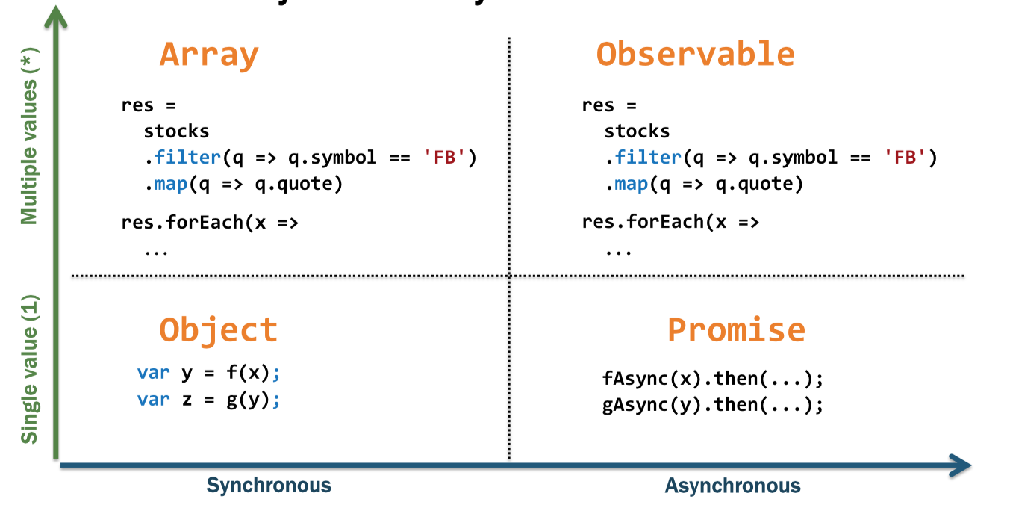
Reactive Programming
Asynchronous data streams
Everything is a stream

Slide 37
Observables
Stream of data over time
Hot vs cold observables
Asynchronous
Lazy
queryable, bufferable, pausable…
more than 120 operations

Slide 38
Observable Creation
Rx.Observable.fromArray([1, 2, 3]);
Rx.Observable.fromEvent(input, ‘click');
Rx.Observable.fromEvent(eventEmitter, 'data', fn);
Rx.Observable.fromCallback(fs.exists);
Rx.Observable.fromNodeCallback(fs.exists);
Rx.Observable.fromPromise(somePromise)
Rx.Observable.fromIterable(function*() {yield 20});

Slide 39
var range = Rx.Observable.range(1, 3); // 1, 2, 3
var range = range.subscribe(
function(value) {},
function(error) {},
function() {}
);
optional

Slide 40
Observable and Subscriber
subscribe
onNext*
Subscriber
Observable
onCompleted

Slide 41
Observable<Integer> source = getData();
Subscriber<Integer> consumer = new Subscriber<Integer>() {
@Override
public void onNext(Integer number){
System.out.println(number); }
@Override
public void onError(Throwable e) {
System.out.println("error"); }
@Override
public void onCompleted() {
System.out.println("completed"); }
};
source.subscribe(consumer);

Slide 42
it
List list = Arrays.asList("One", "Two", "Three", "Four", "Five");
Iterator iterator = list.iterator();
while(iterator.hasNext())
{
System.out.println(iterator.next());
}

Slide 43
observable
Observable observable = Observable.from(…);
observable.subscribe(new Action1() {
@Override
public void call(String element) {
System.out.println(element);
}
});

Slide 44

Observable
Observers
Observable

Slide 45
Iterable v/s Observable
EVENT | ITERABLE (PULL) | OBSERVABLE (PUSH)
retrieve data | T next() | onNext(T)
discover error | throws Exception | onError(Exception)
complete | !hasNext() | onCompleted()

Slide 46
Callbacks
Service A
1
Client
Application
2
Service B
3
Service C
Use case :
Client send a request to the Application
Application calls service A
Get the response from ServiceA and send it to service B
Get the response from ServiceB and send it to Service C
Get the response from ServiceC and send it to the Client

Slide 47
Why Rx
public List<Todo> getTodos() {
List<Todo> todosFromWeb = // query a webservice
(with bad network latency)
return todosFromWeb;
}

Slide 48
non blocking call
public void getTodos(Consumer<List<Todo>> todosCallback) {
Thread thread = new Thread(()-> {
List<Todo> todosFromWeb = // query a webservice
todosCallback.accept(todosFromWeb);
});
thread.start();
}

Slide 49
how to handle errors ?
public void getTodos(FailableCallback<List<Todo>> todosCallback) {
Thread thread = new Thread(()-> {
try {
List<Todo> todosFromWeb = // query a service
todosCallback.accept(todosFromWeb);
} catch(Exception ex) {
todosCallback.error(ex);
}
});
thread.start();
}

Slide 50
one service depends on another
public void getTodos(FailableCallback<List<Todo>> todosCallback) {
Thread thread = new Thread(()-> {
getUserPermission(new FailableCallback() {
public void accept(UserPermission permission) {
if(permission.isValid()) {
try {
List<Todo> todosFromWeb = // query a web service
if(!todosCallbackInstance.isDisposed()) {
if(syncWithUIThread()) {
todosCallback.accept(todosFromWeb);
}
}
} catch(Exception ex) {
if(!todosCallbackInstance.isDisposed()) {
if(syncWithUIThread()) {
todosCallback.error(ex);
}
}
}
}
}
public void error(Exception ex) {
// Oh no!
}
});
});
thread.start();
}
public void getUserPermission(FailableCallback<UserPermission> permissionCallback) {
Thread thread = new Thread(()-> {
try {
UserPermission permission = // query a web service
permissionCallback.accept(permission);
} catch(Exception ex) {
permission.error(ex);
}
});
thread.start();
}

Slide 51
Callback Hell
getPerson(person => {
getPlanet(person, (planet) => {
getGalaxy(planet, (galaxy) => {
console.log(galaxy);
});
});
});
getPerson(person)
.map(person => getPlanet(person))
.map(planet => getGalaxy(planet))
.mergeAll()
.subscribe(galaxy => console.log(galaxy));

Slide 52
Hot vs Cold
COLD is when Producers created *inside*
var cold = new Observable((observer) => {
const source = new Observable((observer) => {
const socket = new WebSocket('ws://someurl');
socket.addEventListener('message', (e) => observer.next(e));
return () => socket.close();
});
HOT is when your Producers created *outside*
const socket = new WebSocket(‘ws://someurl');
const hot = new Observable((observer) => {
socket.addEventListener('message', (e) => observer.next(e));
});
anything that subscribes to `source` will share the same WebSocket instance. It will effectively multicast to all subscribers now.

Slide 53
Hot vs Cold
When an observer subscribes to a hot observable, it will get all values in the stream that are emitted after it subscribes. The values are shared among all subscribers. For example, even if no one has subscribed to a thermometer, it measures and publishes the current temperature. When a subscriber registers to the stream, it automatically receives the next measure.
The data produced by a cold stream is not shared among subscribers and when you subscribe you get all the items.

Slide 54
Hot observable are like event bus (broad cast), who ever listens get the event
Cold observable are like point to point. Message are published for a given subscriber.

Slide 55
Appendix

Slide 56
The Reactive Manifesto
The Reactive Manifesto (http://www.reactivemanifesto.org/) is a document defining the four reactive principles

Slide 57
reactive manifesto vs reactive programming
Using reactive programming does not build a reactive system. Reactive systems, as defined in the reactive manifesto, are an architectural style to build responsive distributed systems. Reactive Systems could be seen as distributed systems done right. A reactive system is characterized by four properties:
Responsive: a reactive system needs to handle requests in a reasonable time (I let you define reasonable).
Resilient: a reactive system must stay responsive in the face of failures (crash, timeout, 500 errors… ), so it must be designed for failures and deal with them appropriately.
Elastic: a reactive system must stay responsive under various loads. Consequently, it must scale up and down, and be able to handle the load with minimal resources.
Message driven: components from a reactive system interacts using asynchronous message passing.
Despite the simplicity of these fundamental principles of reactive systems, building one of them is tricky. Typically, each node needs to embrace an asynchronous non-blocking development model, a task-based concurrency model and uses non-blocking I/O.

Slide 58
Reactive Programming and Reactive eXtension provides a development model to tame the asynchronous beast. By using it wisely, your code is going to stay readable, and understandable. However, using reactive programming does not transform your system into a Reactive System.

Slide 59
if a program propagates all the changes that modify its data to all the interested parties (users, other programs, components, and subparts), then this program can be called reactive.

Slide 60
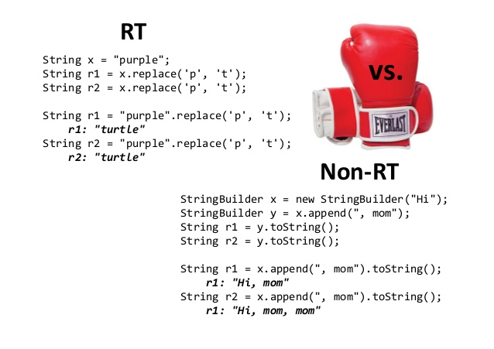

Slide 61
A pure function is a function without side-effects where the output is solely determined by the input
An idempotent function is one that can be applied multiple times without changing the result -
A function can be pure, idempotent, both, or neither.

Slide 62
result of performing some operation should be obvious, consistent, and predictable, based upon the name of the operation

Slide 63
Stream

Slide 64
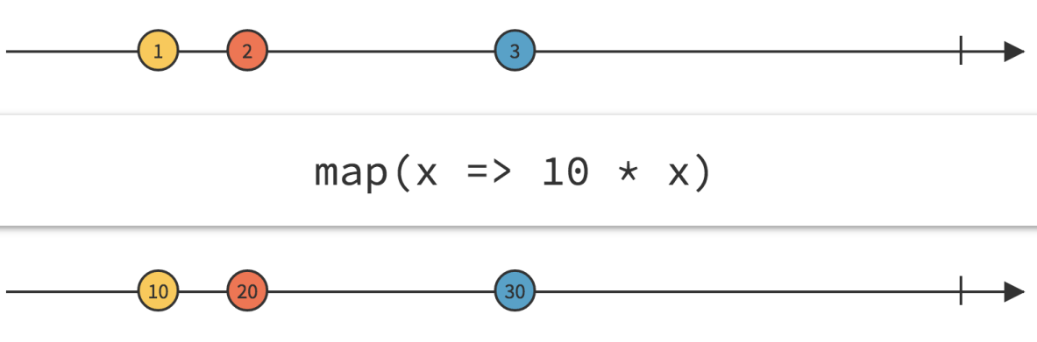
Map

Slide 65
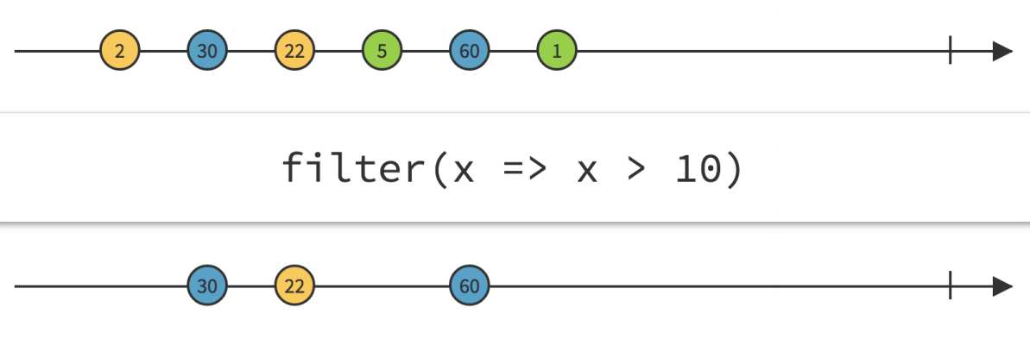
filter

Slide 66
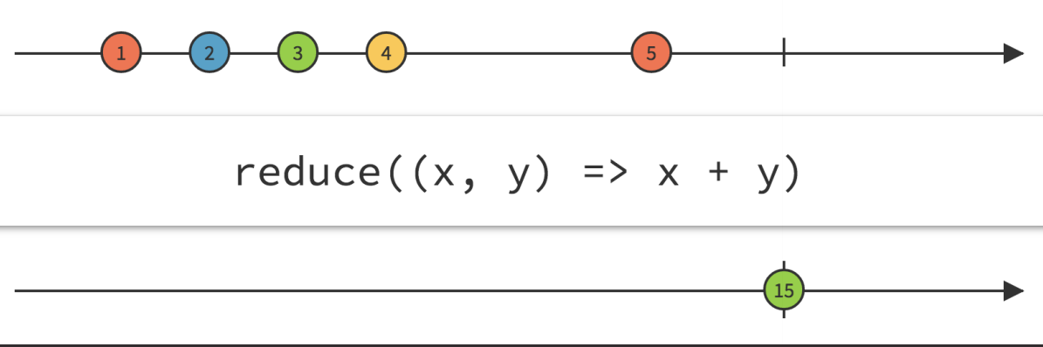
Aggregating

Slide 67
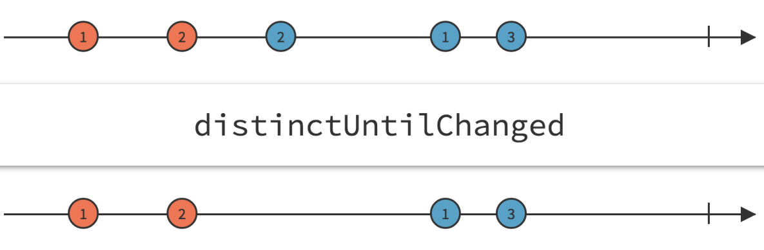
Skip Repeats

Slide 68
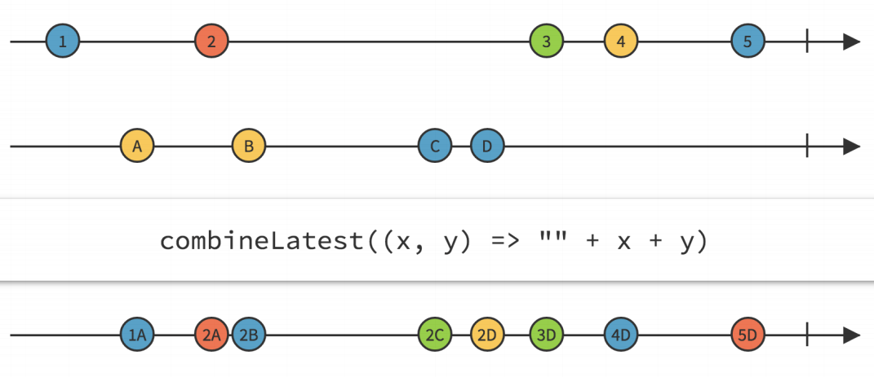
Combine latest

Slide 69
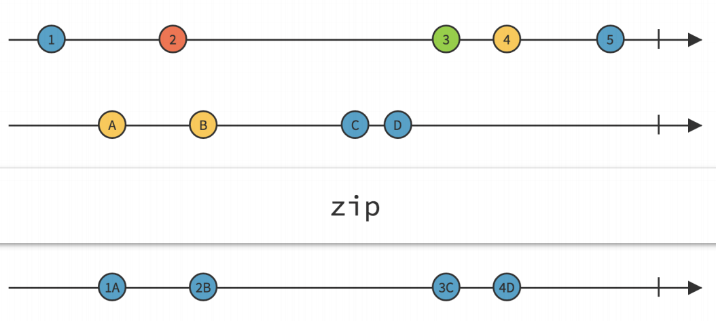
Zip

Slide 70
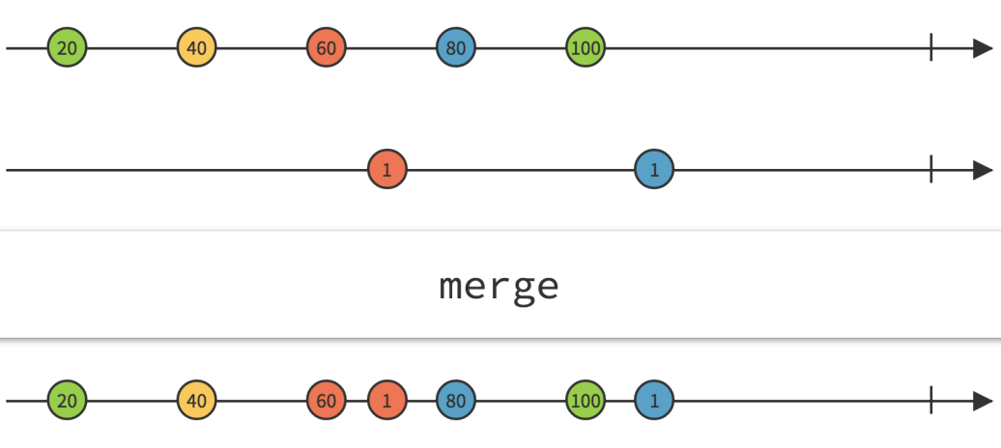
Merge

Slide 71
appendix

Slide 72
FP and OOP are orthogonal in nature.

Slide 73
Reactive programming deals with data. Ultimately this is a special case of event-driven programming.

Slide 74
reactive vs actor

Slide 75
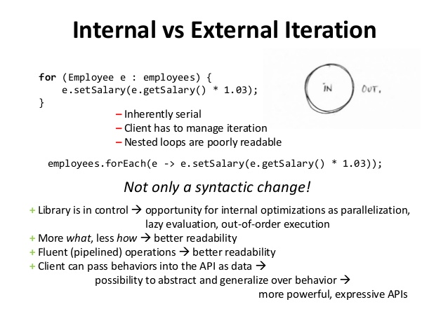

Slide 76
pure functions
A function is pure if it meets two qualifications:
1. ”referential transparency”
2. It doesn't cause any side effects

Slide 77
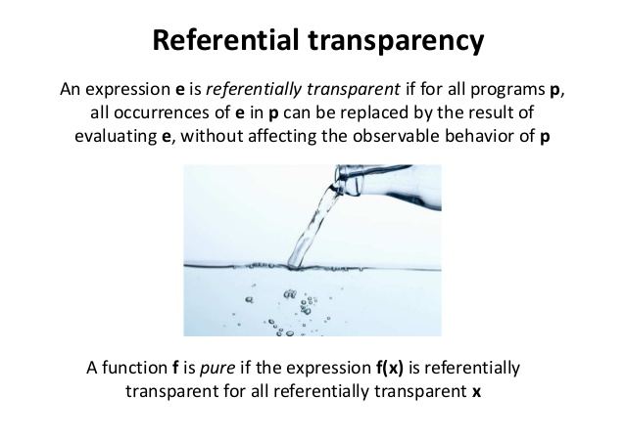

Slide 78
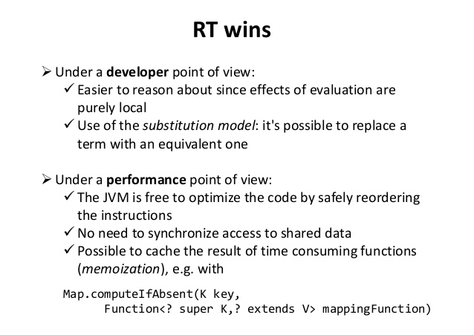

Slide 79
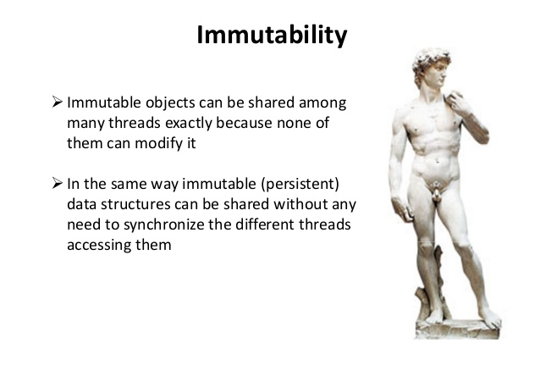

Slide 80
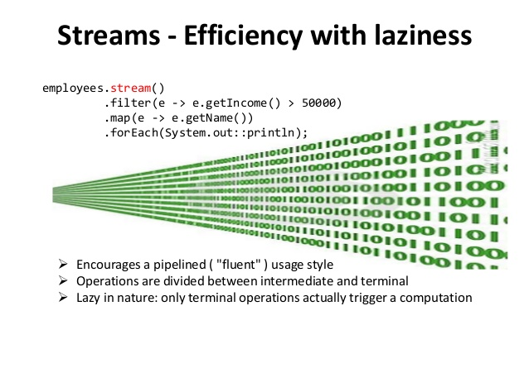

Slide 81
